Slide 1
Object Detection Using Classical CV

Slide 2

Follow up Contents
Classical Computer vision
Image matching problem
Corner Detection
SIFT
HOG
Object Classification + localization and Detection Using Classical CV
Dalal and Trigs: HOG + SVM
DPM
CNN based Ideas for Object detection
Butterfly Learning

Slide 3
Prerequisite
Understanding of SVM or Logistic Regression
Classical CV approaches like HOG
Butterfly Learning

Slide 4
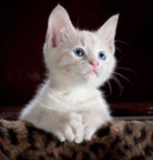
Understanding Classification
Classification
MODEL
Classify
Cat or Not
Cat
Single Object
Butterfly Learning

Slide 5
Understanding Classification Using Classical CV
Classification
MODEL
Classify
Cat or Not
Cat
3780 x 1
Single Object
Feature Extraction
How to train the classifier to classify weather there is cat or not ?
Butterfly Learning

Slide 6
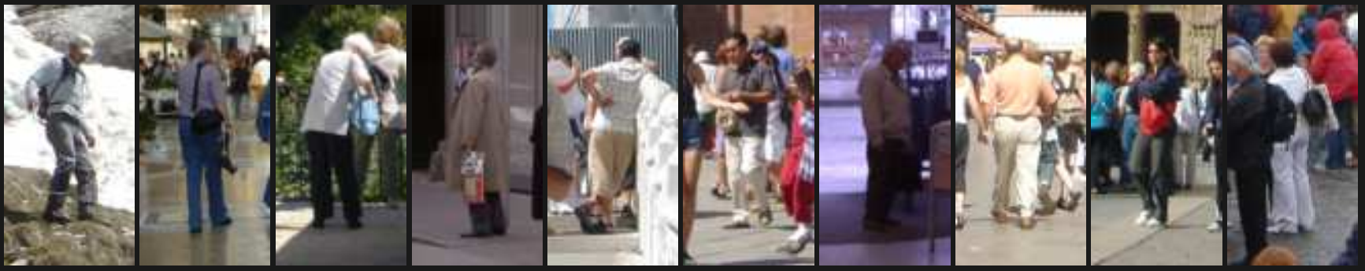
Understanding Classification Using Classical CV
How to train the classifier to classify weather there is cat person or not ?
Navneet Dalal and Bill Triggs
Histograms of Oriented Gradients for Human Detection
~ June 2005
Sample of human detection database
Training Phase
1000 images of person.
1000 images of not a person.
Pass it to HOG feature extractor.
Train SVM to classify person or not.
After training save the trained HOG features of person as template.
Use this template to detect person or not.
Credit: Histograms of oriented gradients for human detection
Butterfly Learning

Slide 7
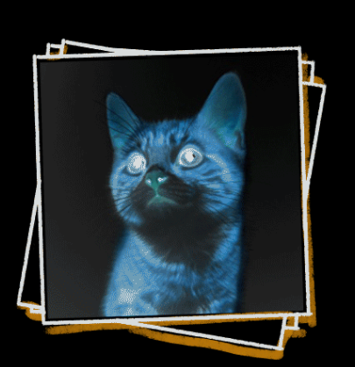
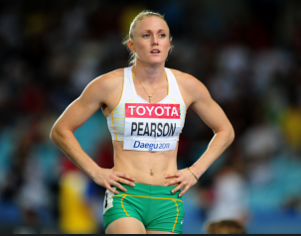
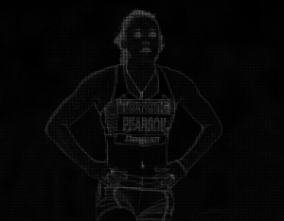
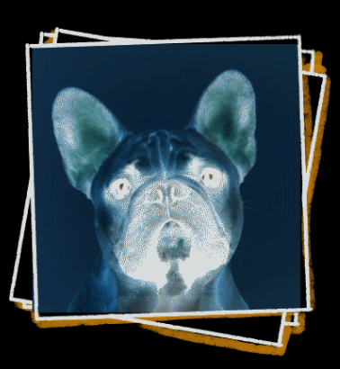
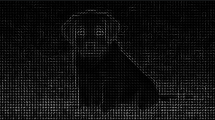
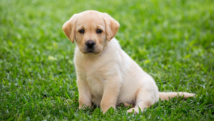
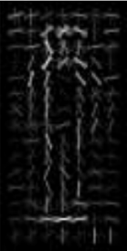
Classification Using Classical CV HOG + SVM
Training
HOG Feature Extractor
SVM Classifier
Person or
Not
Input
Person
3780 x 1
SVM coef
Not person
3780 x 1
Training Phase
1000 images of person.
1000 images of not a person.
Pass it to HOG feature extractor.
Train SVM to classify person or not.
After training save the trained HOG features of person as template.
Person Template
Butterfly Learning

Slide 8
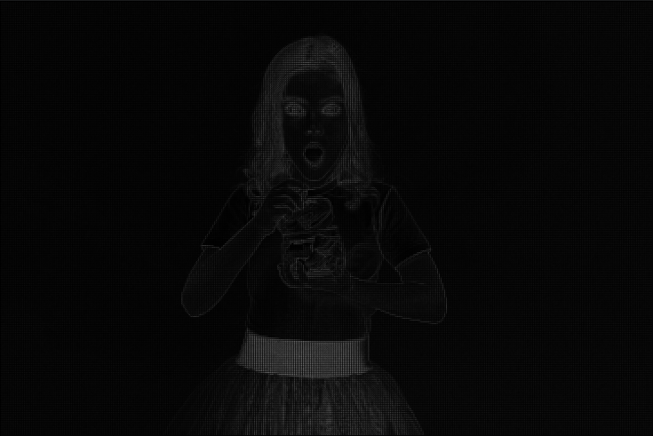

Classification Using Classical CV HOG + SVM
Testing
Resize Hog features and pass to SVM classifier
X
Person
3780 x 1
3780 x 1
Query Input
HOG features
SVM coef
X . W^{t} + b
But, what about multi classification ?
Butterfly Learning

Slide 9
Training for Multi Class
HOG Feature Extractor
SVM Classifier
A
Class A or
Not
Class A
SVM Classifier
B
Class B or
Not
Class 2
Class k
SVM Classifier
K
Class K or
Not
K class Images input
K # of SVM binary classifier
Butterfly Learning

Slide 10
Testing for multi class
SVM Classifier
A
Class A or
Not
Person
95 % confidence
SVM Classifier
B
Class B or
Not
Class B
10 % confidence
Query Input
HOG features
SVM Classifier
K
Class K or
Not
Class C
20 % confidence
K # of SVM binary classifier
Butterfly Learning

Slide 11
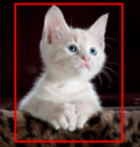
Understanding Localization
bx
by
bh
bw
Localize Bounding Box of single object
Classification and Localization
MODEL
Cat + Bounding Box
Classify
Cat or Not
Feature Extraction
Single Object + Localized
Butterfly Learning
Butterfly Learning

Slide 12
Localization Using Dalal and Trigs Detector
How to find Bounding BOX ?
w₁
x₁ , y₁
x₁
y₁
h₁
w₁
.
x₁
y₁
x₂
y₂
h₁
x₁ , y₁
x₂ , y₂
Method 1
Method 2
Butterfly Learning

Slide 13
Localization Using Dalal and Trigs Detector
How to find Localize Bbox in query image ?
Sliding Window Approach
Butterfly Learning

Slide 14

Localization Using Dalal and Trigs Detector
Sliding Window Approach
How to find Localize Bbox in query image ?
Crop 1
Note: pixel by pixel sliding window
Butterfly Learning

Slide 15


Localization Using Dalal and Trigs Detector
Sliding Window Approach
How to find Localize Bbox in query image ?
Confidence score 1
0.40
0.45
0.20
_
_
_
_
0.70
0.80
0.75
0.60
_
Crop 1
Confidence score 2
MODEL
Crop 1
Crop k
Confidence score k
Note: pixel by pixel sliding window
Butterfly Learning

Slide 16
Localization Using Dalal and Trigs Detector
How to find Localize Bbox in query image ?
Confidence Score for Each window
Note: pixel by pixel sliding window
Butterfly Learning

Slide 17
Localization Using Dalal and Trigs Detector
How to find Localize Bbox in query image ?
 |  | 60 | 72 | 78
 |  | 75 | 80 | 60
 |  | 55 | 68 | 55
Confidence Score for Each window
Note: pixel by pixel sliding window
Butterfly Learning

Slide 18
Localization Using Dalal and Trigs Detector
How to find Localize Bbox in query image ?
 |  | 60 | 72 | 78
 |  | 75 | 80 | 60
 |  | 55 | 68 | 55
x₁
y₁
x₂
y₂
Confidence Score for Each window
Choose top confidence score Bbox and Remove Other Bbox
Note: pixel by pixel sliding window
Butterfly Learning

Slide 19
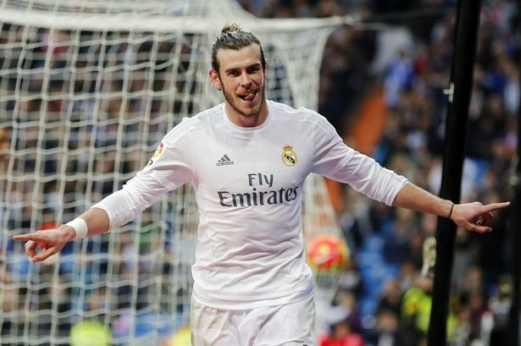
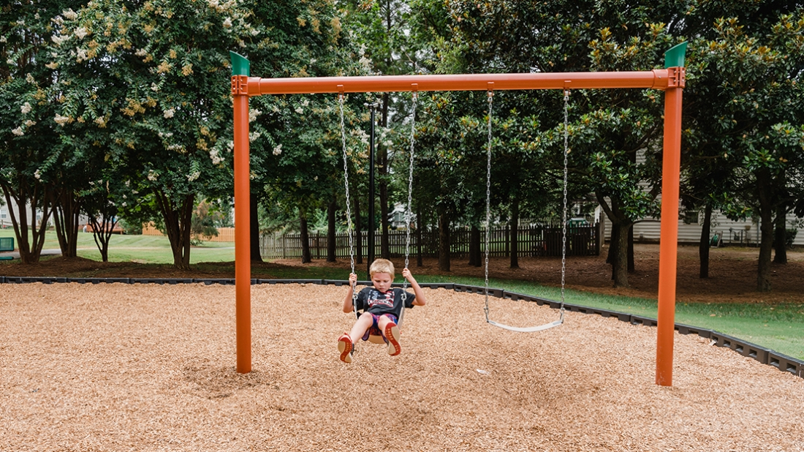
Localization Using Dalal and Trigs Detector
Problem of having same window size for all image
Correct BBox
Fixed window size BBox
Butterfly Learning

Slide 20
Localization Using Dalal and Trigs Detector – Image Pyramid
Butterfly Learning

Slide 21
Localization Using Dalal and Trigs Detector – Image Pyramid
Multiple Crops
of each scale image
Confidence score 1
0.40
0.45
0.20
_
_
_
_
0.70
0.80
0.75
0.60
_
0.40
0.45
0.20
_
_
_
_
_
_
_
_
_
Confidence score 2
MODEL
Confidence score k
Image Pyramid
Scaled
image 1
Scaled
image 2

Slide 22
Localization Using Dalal and Trigs Detector – Image Pyramid
Multiple Crops
of each scale image
Confidence score 1
0.40
0.45
0.20
_
_
_
_
0.70
0.80
0.75
0.60
_
0.40
0.45
0.20
_
_
_
_
_
_
_
_
_
Confidence score 2
MODEL
Image Pyramid
Confidence score k
Scaled
image 1
Scaled
image 2

Slide 23
Localization Using Dalal and Trigs Detector
How to find Localize Bbox in query image ?
 |  | 60 | 72 | 78
 |  | 75 | 80 | 60
 |  | 55 | 68 | 55
Confidence Score for Each window
Note: pixel by pixel sliding window
Butterfly Learning

Slide 24
Localization Using Dalal and Trigs Detector
How to find Localize Bbox in query image ?
x₁
y₁
x₂
y₂
 |  | 60 | 72 | 78
 |  | 75 | 80 | 60
 |  | 55 | 68 | 55
Confidence Score for Each window and each scaled Image
Choose top confidence score Bbox and Remove Other Bbox
Butterfly Learning

Slide 25
Localization Using Dalal and Trigs Detector
Localization Problem: Sliding window
Size Problem: Image Pyramid
Image Pyramid
Butterfly Learning

Slide 26
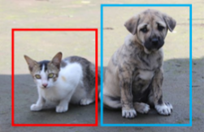
Understanding Object Detection
bx
by
bh
bw
Localize Bounding Box of multiple objects
Object Detection
MODEL
Cat and Dog + Bounding Box
Classify
Multi Classes
Multiple Objects + Localize all objects
Cat and Dog
Butterfly Learning

Slide 27

Understanding Object Detection
Can we use all the previously learned Concept for Object Detection ?
HOG +SVM
Sliding Window
Image Pyramid
Image Credit: Freepik
Butterfly Learning

Slide 28
Object Detection Using Dalal and Trigs Detector
Image with ground truth
Sliding Window
Image Pyramid + Sliding Window
Butterfly Learning

Slide 29
Object Detection Using Dalal and Trigs Detector
Multiple Crops
of each scale image
Confidence score 1
0.40
0.45
0.20
_
_
_
_
0.70
0.80
0.75
0.60
_
0.40
0.45
0.20
_
_
_
_
_
_
_
_
_
Confidence score 2
MODEL
Image Pyramid + Sliding Window
Confidence score k
Butterfly Learning

Slide 30
Object Detection Using Dalal and Trigs Detector
60 | 72 | 78
79 | 88 | 65 |  |  |  |  | 66 | 72 | 79
55 | 68 | 58 | 60 | 72 | 78 |  | 75 | 83 | 62
 |  |  | 72 | 85 | 60 |  | 55 | 68 | 55
 |  |  | 55 | 68 | 55
Confidence Score for Each window and each scaled Image
Should we Choose only top score confidence score Bbox and discard rest ?
Butterfly Learning

Slide 31
Object Detection Using Dalal and Trigs Detector
Let’s see what will happen If we choose only top confidence score Bbox
60 | 72 | 78
79 | 88 | 65 |  |  |  |  | 66 | 72 | 79
55 | 68 | 58 | 60 | 72 | 78 |  | 75 | 83 | 62
 |  |  | 72 | 85 | 60 |  | 55 | 68 | 55
 |  |  | 55 | 68 | 55
Confidence Score for Each window and each scaled Image
We cannot choose only top confidence score Bbox and discard rest for Object Detection tasks
Butterfly Learning

Slide 32
Object Detection Using Dalal and Trigs Detector - NMS
Intersection Over Union – IOU
Ground Truth BBox
Predicted BBox
A
B
A ∩ B
A U B
Intersection
IOU =
Union
Butterfly Learning

Slide 33
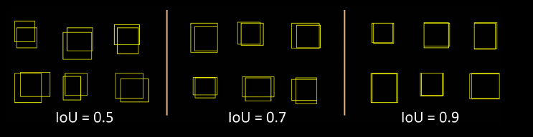
Object Detection Using Dalal and Trigs Detector - NMS
Intersection Over Union – IOU
Ground Truth BBox
Predicted BBox
A
B
Intersection
IOU =
A ∩ B
A U B
Union

Slide 34
Object Detection Using Dalal and Trigs Detector - NMS
Non Max suppression - NMS
Remove all the Bbox where confidence score < 0.5
Choose Bbox having highest confidence score and compute the IOU score w.r.t remaining Bbox
Butterfly Learning

Slide 35
Object Detection Using Dalal and Trigs Detector - NMS
Non Max suppression - NMS
Remove all the Bbox where confidence score < 0.5
Choose Bbox having highest confidence score and compute the IOU score w.r.t remaining Bbox
Discard all the Bbox having IOU > 0.7
Left with Bbox for 1 instance of object.
Choose Bbox having next highest confidence score and repeat step 2 to 5.
Butterfly Learning

Slide 36
Object Detection Using Dalal and Trigs Detector - NMS
Non Max suppression - NMS
Remove all the Bbox where confidence score < 0.5
Choose Bbox having highest confidence score and compute the IOU score w.r.t remaining Bbox
Discard all the Bbox having IOU > 0.7
Left with Bbox for 1 instance of object.
Choose Bbox having second highest confidence score and repeat step 2 to 5.
Butterfly Learning

Slide 37
Object Detection Using Dalal and Trigs Detector - NMS
Non Max suppression - NMS
Remove all the Bbox where confidence score < 0.5
Choose Bbox having highest confidence score and compute the IOU score w.r.t remaining Bbox
Discard all the Bbox having IOU > 0.7
Left with Bbox for 1 instance of object.
Choose Bbox having second highest confidence score and repeat step 2 to 5.
Butterfly Learning

Slide 38
Object Detection Using Dalal and Trigs Detector
Multi Class Object Detection
SVM Classifier
A
Class A OD
NMS
MODEL
SVM Classifier
B
Sliding Window
+
Image Pyramid
Class B OD
NMS
SVM Classifier
K
Class K OD
Query Input
NMS
K # of SVM binary classifier

Slide 39
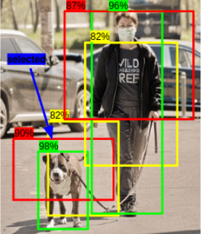
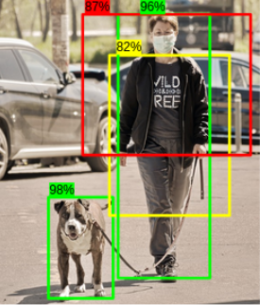
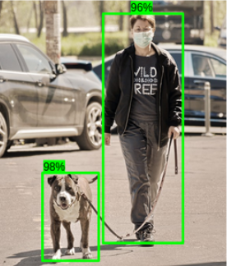
Object Detection Using Dalal and Trigs Detector - NMS
Non Max suppression - NMS
Example
Step 3 :
Repeat Step 1 and step 2
Step 1 : select the Bbox with height score
Step 2 : Delete Bbox with high over lap
Step 4 : Final output
Credit: https://www.analyticsvidhya.com/blog/2020/08/selecting-the-right-bounding-box-using-non-max-suppression-with-implementation/
Butterfly Learning

Slide 40
Object Detection Using Dalal and Trigs Detector
HOG future extractor + SVM Classifier
Sliding window for location of Bbox
Image pyramid to detect various size of object
Multi Class SVM model
NMS for removing unnecessary Bbox and final prediction
Butterfly Learning

Slide 41
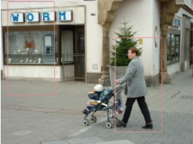
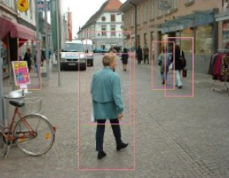
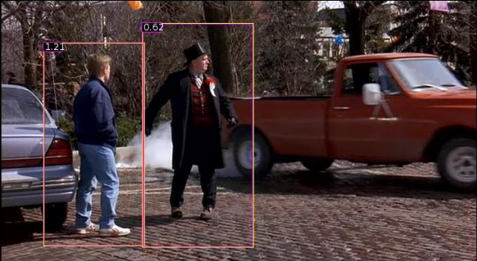
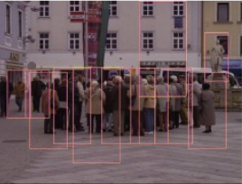
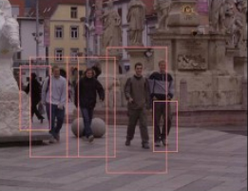
Object Detection Using Dalal and Trigs Detector
Research Paper Results
Butterfly Learning

Slide 42
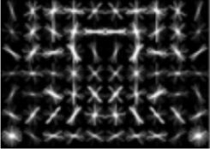
Classification Using Classical CV HOG + SVM
Problem with HOG + SVM classifier
Bicycle Detection
Training
SVM Classifier
1000 bicycle image
1000 non bicycle images
HOG Feature Extractor
Bicycle Template
Input
SVM coef
SVM coef
Butterfly Learning

Slide 43
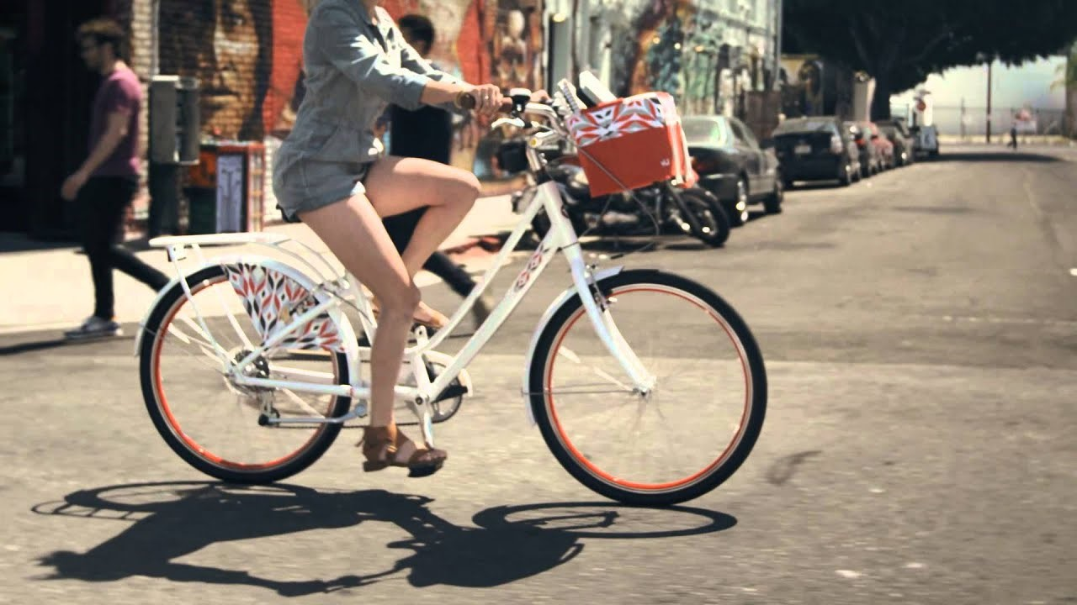
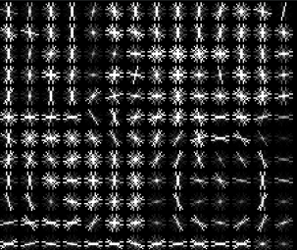
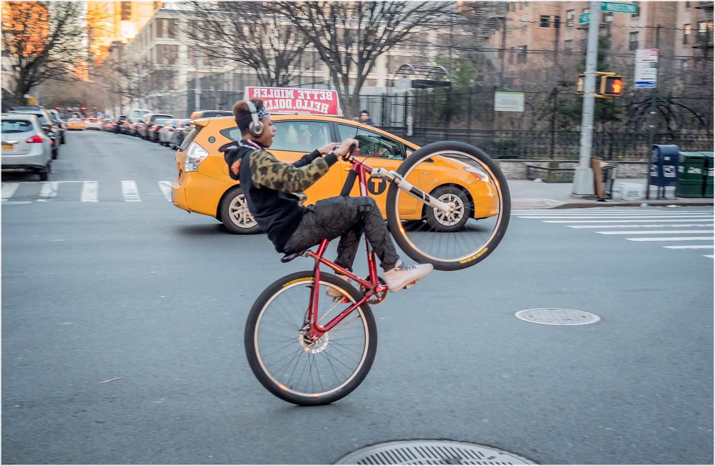
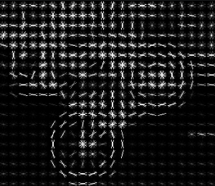
Classification Using Classical CV HOG + SVM
Problem with HOG + SVM classifier
Bicycle Detection
Testing
X
Bicycle
X
Not Bicycle
HOG features resized
SVM coef of bicycle
But, Why ?
Butterfly Learning

Slide 44
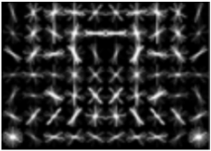
Classification Using Classical CV HOG + SVM
Problem with HOG + SVM classifier
Bicycle Detection
Testing
Bicycle
Not Bicycle
Original Input
Input overlap with SVM coef of bicycle template
SVM coef of bicycle template
Butterfly Learning

Slide 45
Classification Using Classical CV HOG + SVM
Possible Solution
Treat Various angles of bicycle as one class and perform Multi Class Classification.
Class K
Class A
Class B
Deformable Parts Model
Butterfly Learning

Slide 46
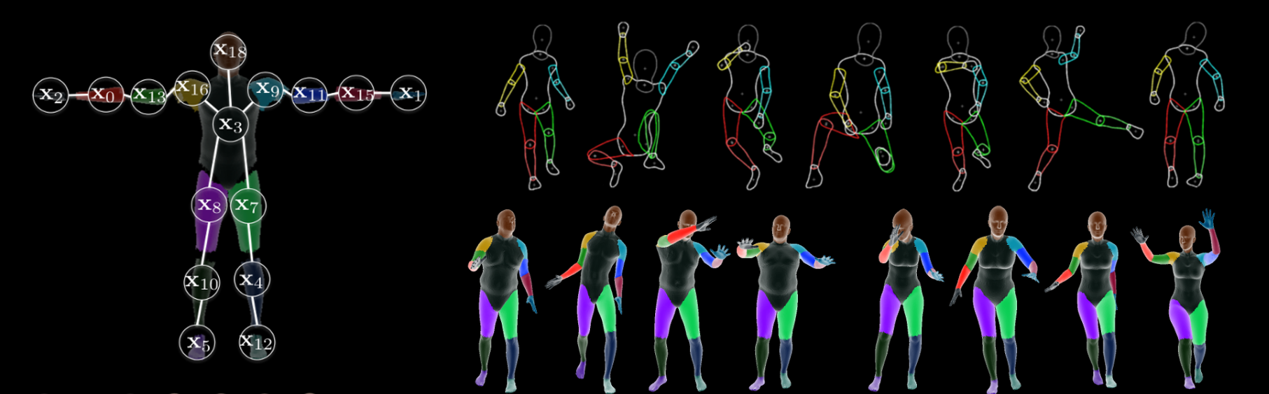
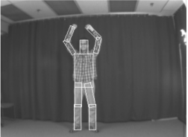
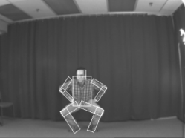
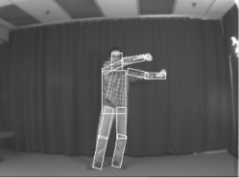
Object Detection Using Classical CV Deformable Parts Model
Deformable Parts Model
Sample of human detection database
Image Credit: https://ps.is.tuebingen.mpg.de/research_projects/part-based-body-models
Butterfly Learning

Slide 47
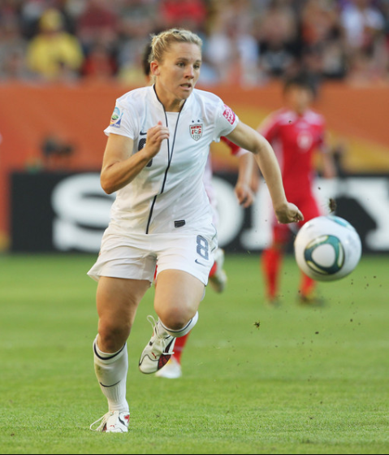
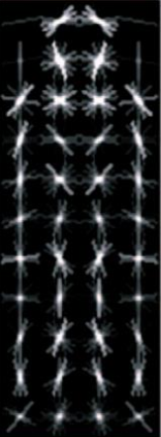
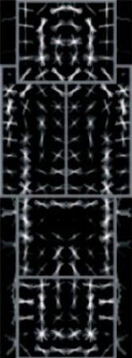
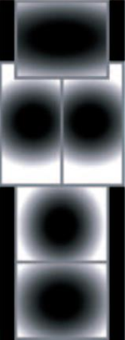
Object Detection Using Classical CV Deformable Parts Model
Deformable Parts Model
Multi Part Detector
Multi Part
Detector
Coarse Root
Filter
Higher Resolution
Part Filter
Spatial Model
for each Part
Query input
Butterfly Learning

Slide 48
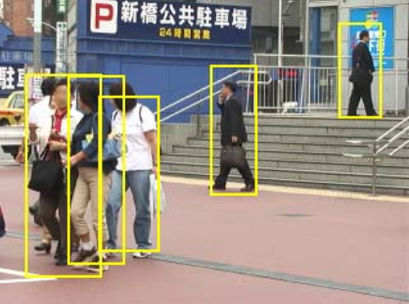
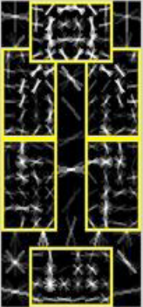
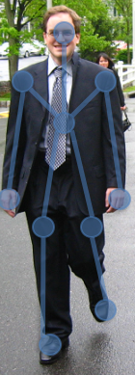
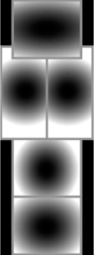
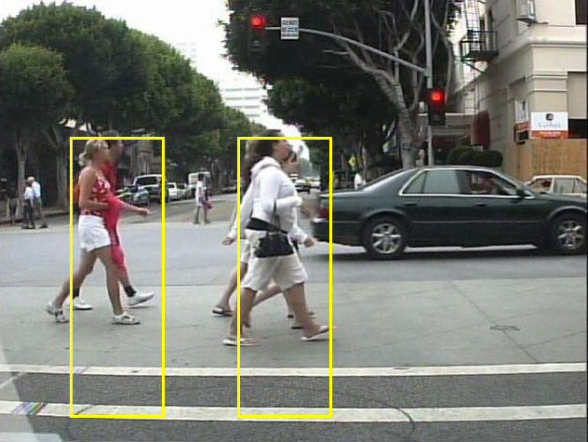
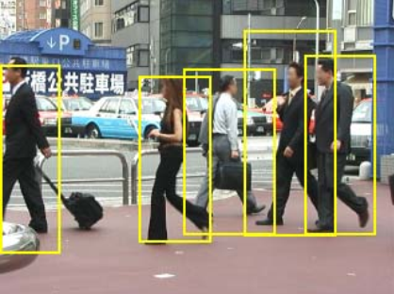
Object Detection Using Classical CV Deformable Parts Model
Deformable Parts Model
What is deformation cost ?
Part Filter
Query image
Deformation costs
Credit: Pedestrian Detection in Crowded Scenes Paper
Butterfly Learning

Slide 49
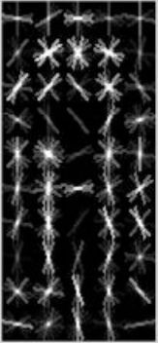
Classification Using Classical CV Deformable Parts Model
Deformable Parts Model
Training for Person Detection
Training
SVM Classifier
1000 human image
1000 non human images
HOG Feature Extractor
Human Template
SVM coef

Slide 50
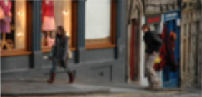
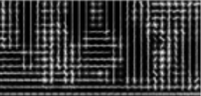
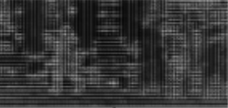
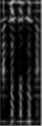
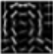
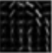






Deformable Parts Model
Test Image
Testing for human detection
Feature Map
Feature Map at 2x resolution
1st Part Filter
n^{th} Part Filter
Root Filter
Down sample
Response of part Filters
Transformed Response
Down sample
Detection Score for each root location

Slide 51




Classification Using Classical CV Deformable Parts Model
Deformable Parts Model
Testing for Bicycle Detection
Butterfly Learning

Slide 52
Classification Using Classical CV Deformable Parts Model
Deformable Parts Model
Testing for Bicycle Detection
+
Bicycle
+
Bicycle
Original Input
Butterfly Learning

Slide 53

















Classification Using Classical CV Deformable Parts Model
Eight view based bicycle detection
Making DPM Robust – Multi position Training
Root Parts
Part filter
Finer resolution
Deformation Costs
Credit: https://www.slideserve.com/caden/vision-based-3d-bicycle-tracking-using-deformable-part-model
Butterfly Learning

Slide 54



Classification Using Classical CV Deformable Parts Model
Eight view based bicycle detection
Research Paper Results
Credit: https://www.slideserve.com/caden/vision-based-3d-bicycle-tracking-using-deformable-part-model
Butterfly Learning

Slide 55




















Classification Using Classical CV Deformable Parts Model
Making DPM Robust – Multi position Training
Multiple View Car Detection
Multiple View Person Detection
Credit: https://www.slideserve.com/caden/vision-based-3d-bicycle-tracking-using-deformable-part-model
Butterfly Learning

Slide 56






Classification Using Classical CV Deformable Parts Model
Multiple View Person Detection Result
Multiple View Car Detection Result
Butterfly Learning

Slide 57
Object Detection Summary
Classical Computer vision
Image matching problem
Corner Detection
SIFT
HOG
Object Classification + localization and Detection Using Classical CV
Dalal and Trigs: HOG + SVM
DPM
CNN based Ideas for Object detection
Butterfly Learning

